Slide 1
APPROXIMATE COUNTING & Martingales
CS5330: Randomized Algorithms
Lecture 11
31/03/2020

Slide 2
Admin stuff
Week 11 problem set out
Optional problem sets for Hashing & Markov chains out.
Midterm grades out with solution sketch.
Week 13 lecture cancelled. Replaced by Midterm 2.

Slide 3
Agenda
An important application of approximate sampling: approximate counting
More general Chernoff-like bounds: martingales

Slide 4
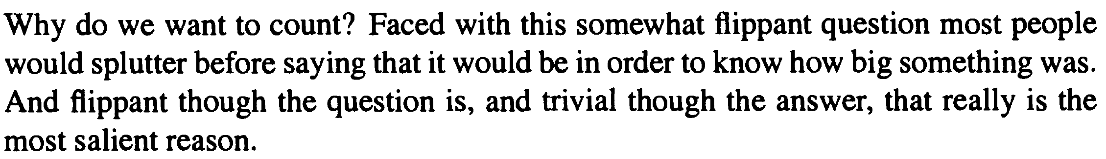
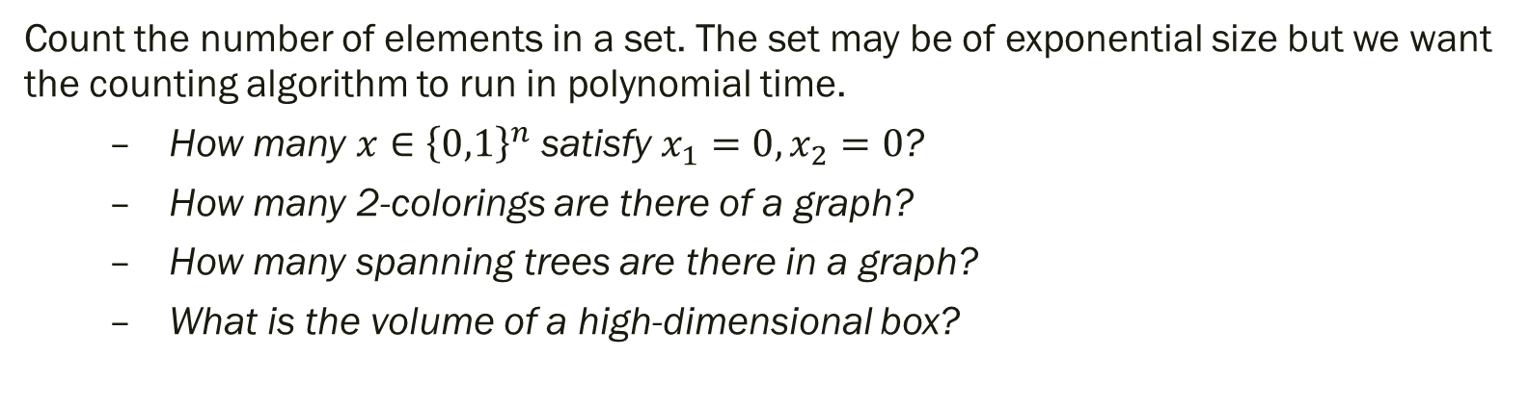
Counting
(Russ Bubley, 2001)
Count the number of elements in a set. The set may be of exponential size but we want the counting algorithm to run in polynomial time.
  How many $x∈{\left\{0,1\right\}}^{n}$ satisfy $x_{1}=0, x_{2}=0$?
  How many 2-colorings are there of a graph?
  How many spanning trees are there in a graph?
  What is the volume of a high-dimensional box?

Slide 5
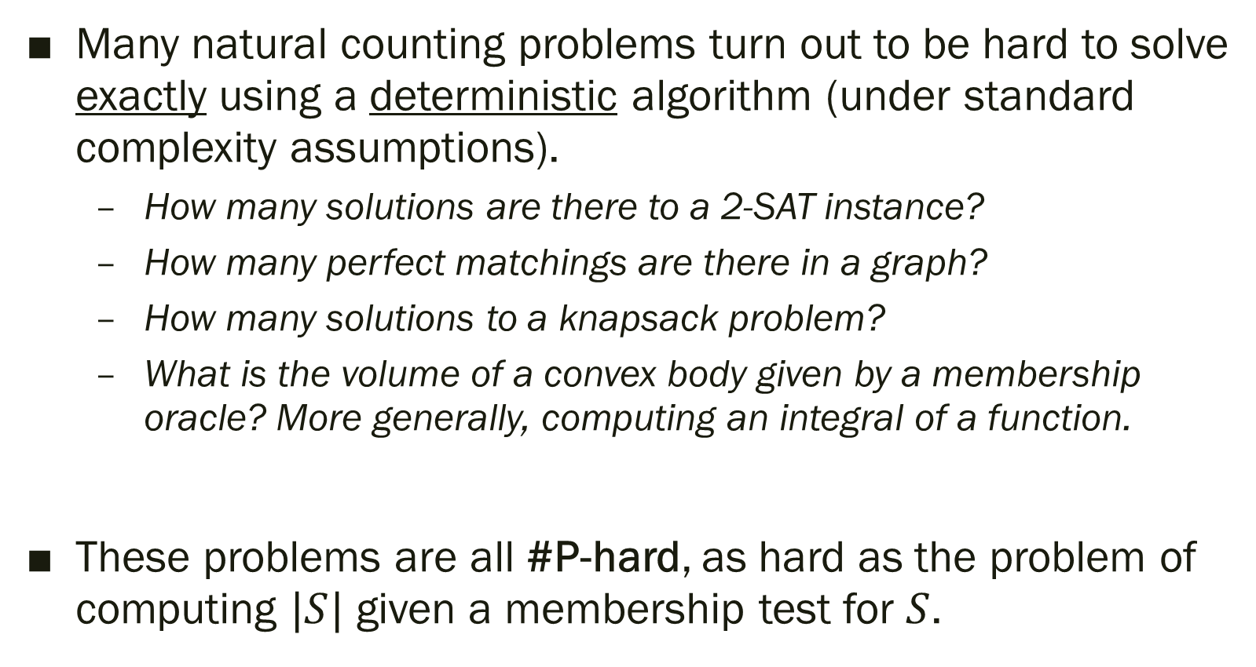
#P-hardness
Many natural counting problems turn out to be hard to solve exactly using a deterministic algorithm (under standard complexity assumptions).
  How many solutions are there to a 2-SAT instance?
  How many perfect matchings are there in a graph?
  How many solutions to a knapsack problem?
  What is the volume of a convex body given by a membership oracle? More generally, computing an integral of a function.
These problems are all #P-hard, as hard as the problem of computing $|S|$ given a membership test for $S$.

Slide 6
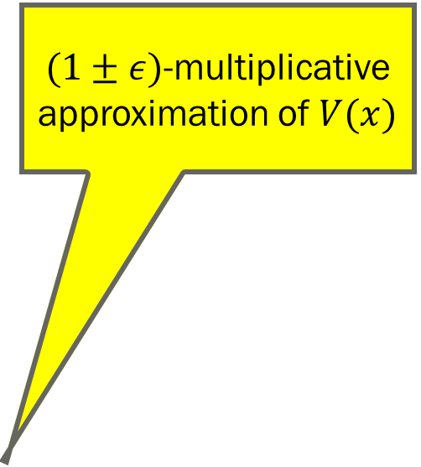
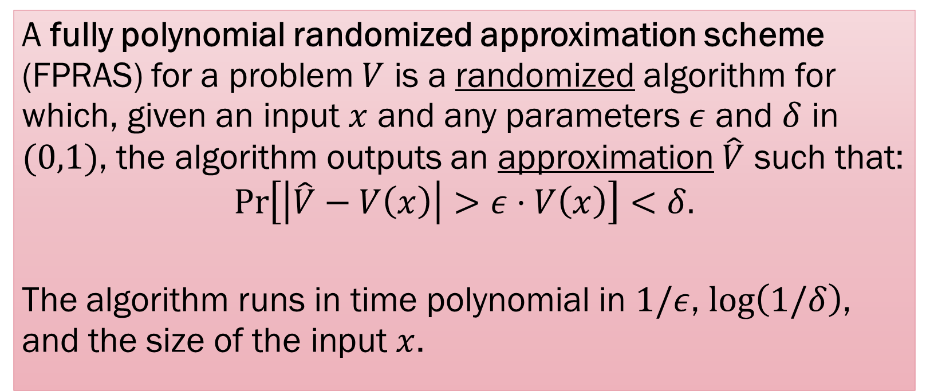
FPRAS
$(1±ε)$-multiplicative approximation of $V(x)$
A fully polynomial randomized approximation scheme (FPRAS) for a problem $V$ is a randomized algorithm for which, given an input $x$ and any parameters $ε$ and $δ$ in $(0,1)$, the algorithm outputs an approximation $\hat{V}$ such that:
$$\operatorname{Pr}\left[\left|\hat{V}−V\left(x\right)\right|>ε⋅V\left(x\right)\right]<δ.$$
The algorithm runs in time polynomial in $1/ε$, $\log\left(1/δ\right)$, and the size of the input $x$.

Slide 7
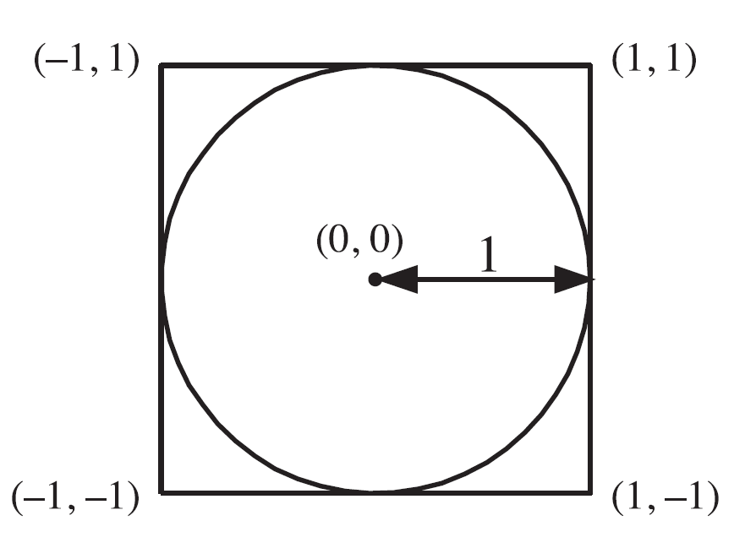
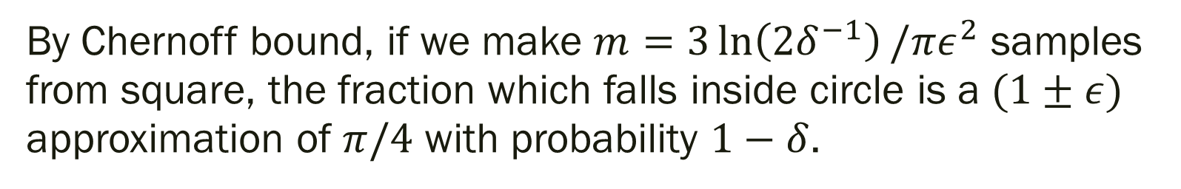
FPRAS for area estimation
By Chernoff bound, if we make $m=3\ln\left(2δ^{−1}\right)/πε^{2}$ samples from square, the fraction which falls inside circle is a $(1±ε)$ approximation of $π/4$ with probability $1−δ$.

Slide 8
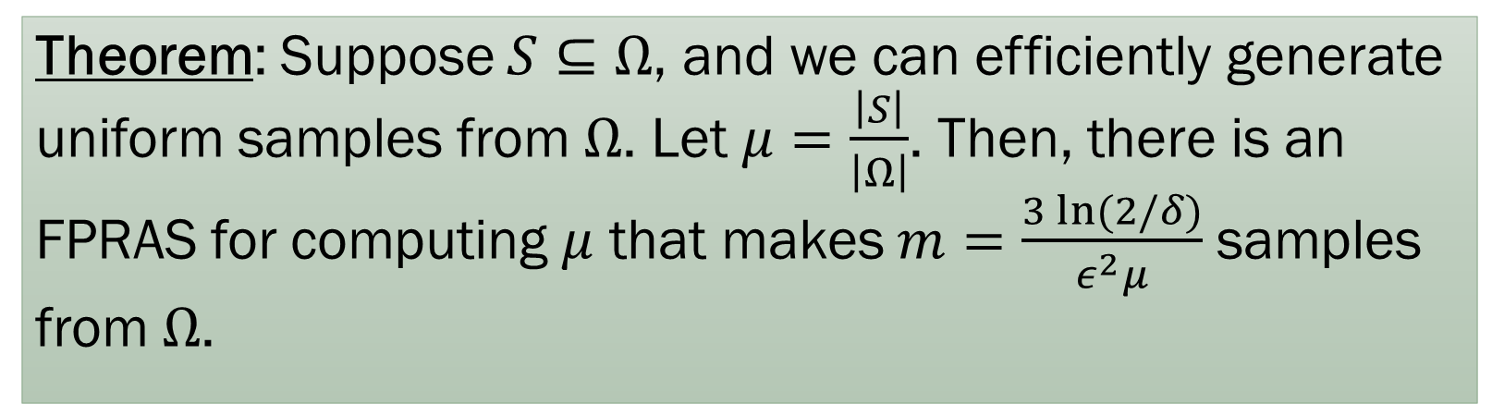
FPRAS for size estimation
Theorem: Suppose $S⊆Ω$, and we can efficiently generate uniform samples from $Ω$. Let $μ=\frac{\left|S\right|}{\left|Ω\right|}$. Then, there is an FPRAS for computing $μ$ that makes $m=\frac{3 ln⁡(2/δ)}{ε^{2}μ}$ samples from $Ω$.
Somewhat paradoxically, situation is worse for smaller $S$.

Slide 9
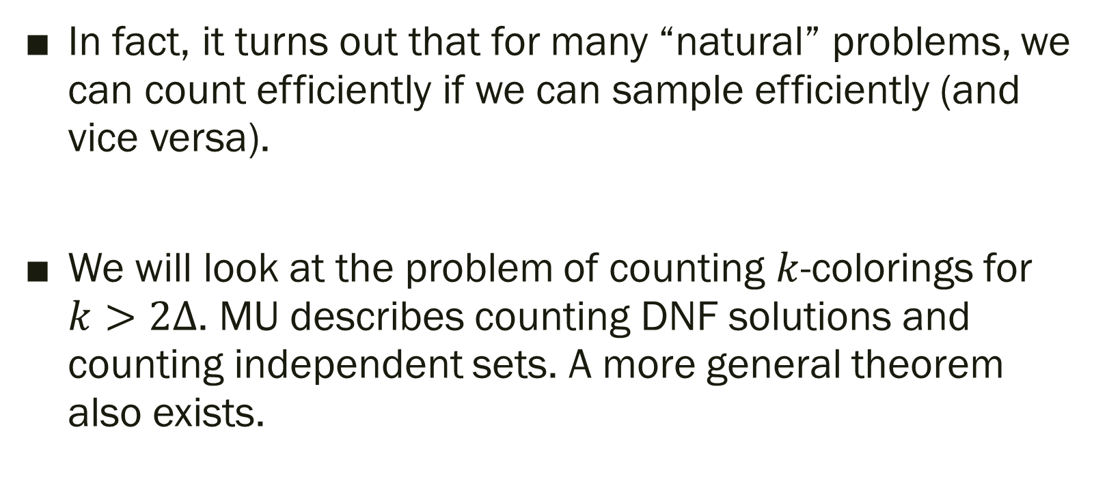
Relationship between Sampling & Counting
In fact, it turns out that for many “natural” problems, we can count efficiently if we can sample efficiently (and vice versa).
We will look at the problem of counting $k$-colorings for $k>2Δ$. MU describes counting DNF solutions and counting independent sets. A more general theorem also exists.

Slide 10
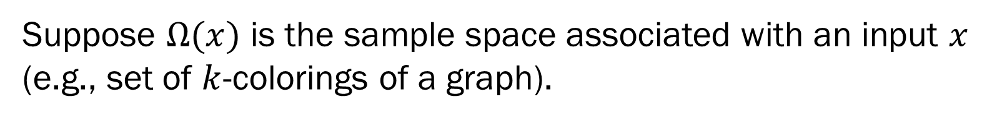
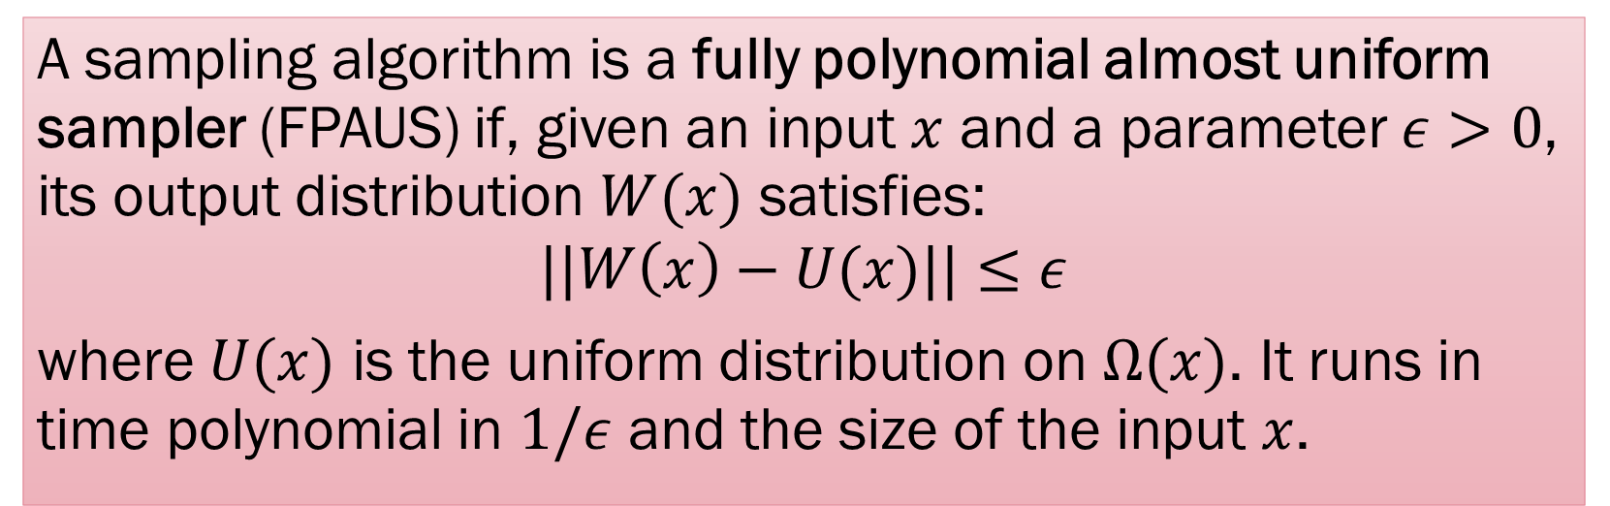
FPAUS
Suppose $Ω(x)$ is the sample space associated with an input $x$ (e.g., set of $k$-colorings of a graph).
A sampling algorithm is a fully polynomial almost uniform sampler (FPAUS) if, given an input $x$ and a parameter $ε>0$, its output distribution $W(x)$ satisfies:
$$||W\left(x\right)−U(x)||≤ε$$
where $U(x)$ is the uniform distribution on $Ω(x)$. It runs in time polynomial in $1/ε$ and the size of the input $x$.

Slide 11
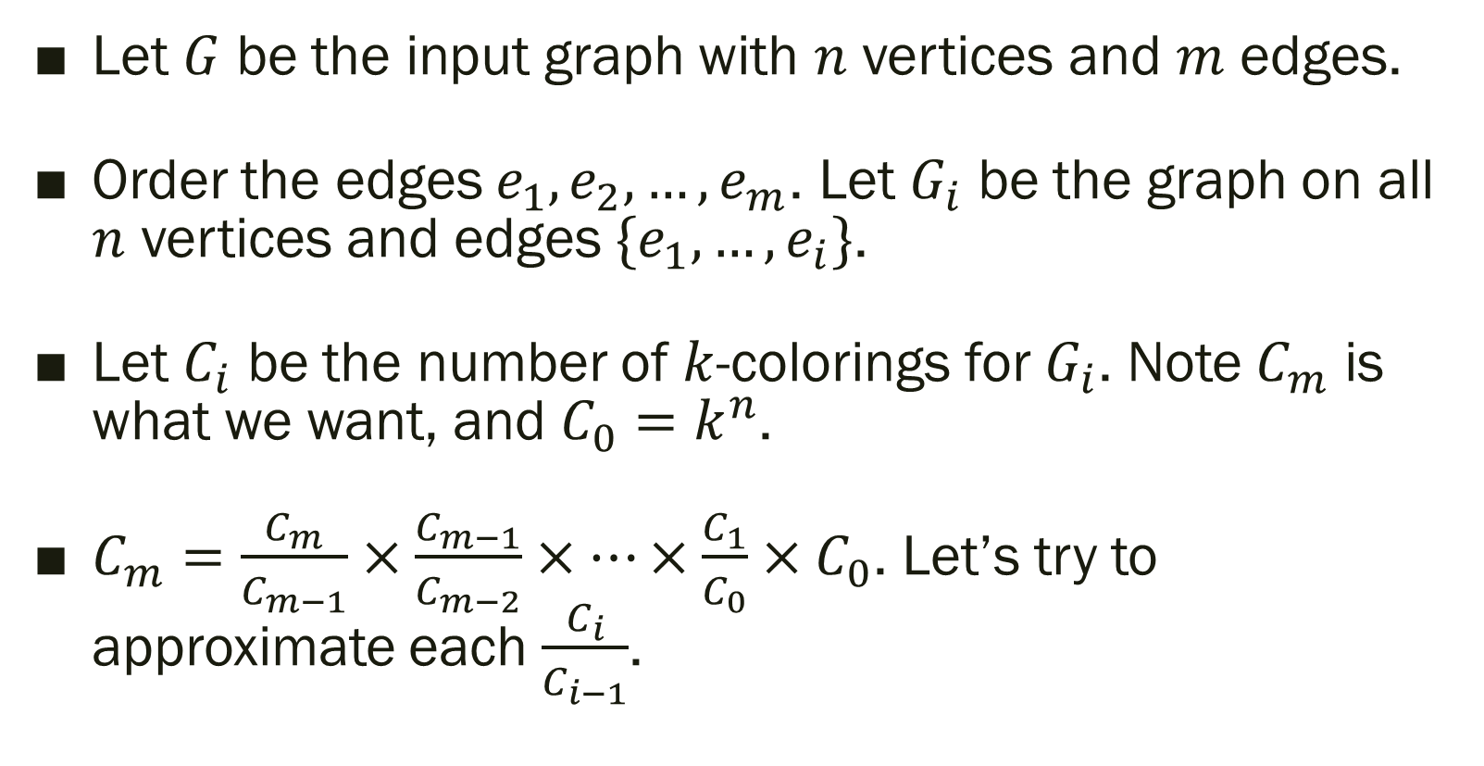

FPAUS to FPRAS: $k$-coloring
Let $G$ be the input graph with $n$ vertices and $m$ edges.
Order the edges $e_{1},e_{2},…, e_{m}$. Let $G_{i}$ be the graph on all $n$ vertices and edges $\{e_{1},…, e_{i}\}$.
Let $C_{i}$ be the number of $k$-colorings for $G_{i}$. Note $C_{m}$ is what we want, and $C_{0}=k^{n}$.
$C_{m}=\frac{C_{m}}{C_{m−1}}×\frac{C_{m−1}}{C_{m−2}}×⋯×\frac{C_{1}}{C_{0}}×C_{0}$. Let’s try to approximate each $\frac{C_{i}}{C_{i−1}}$.

Slide 12
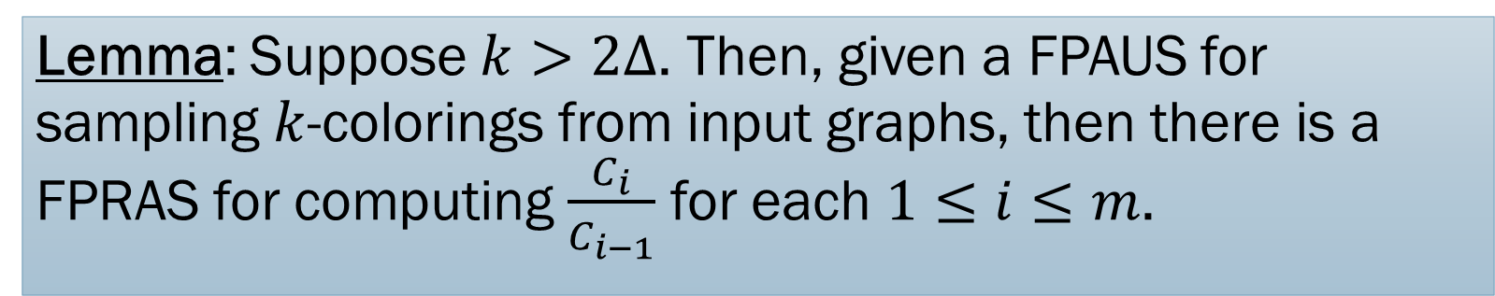
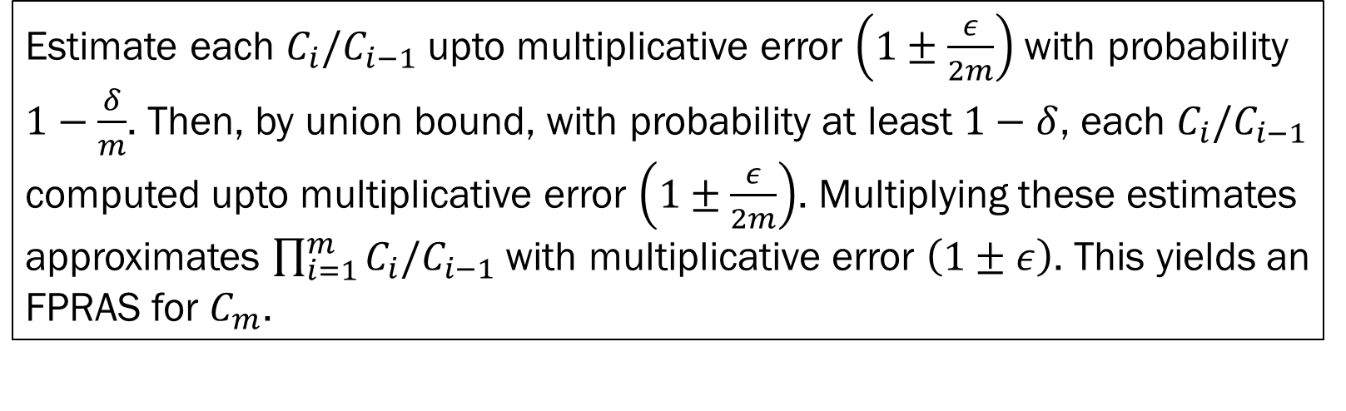
FPAUS to FPRAS: $k$-coloring
Lemma: Suppose $k>2Δ$. Then, given a FPAUS for sampling $k$-colorings from input graphs, then there is a FPRAS for computing $\frac{C_{i}}{C_{i−1}}$ for each $1≤i≤m$.
Estimate each $C_{i}/C_{i−1}$ upto multiplicative error $\left(1±\frac{ε}{2m}\right)$ with probability $1−\frac{δ}{m}$. Then, by union bound, with probability at least $1−δ$, each $C_{i}/C_{i−1}$ computed upto multiplicative error $\left(1±\frac{ε}{2m}\right)$. Multiplying these estimates approximates $\prod_{i=1}^{m}{C_{i}/C_{i−1}}$with multiplicative error $\left(1±ε\right)$. This yields an FPRAS for $C_{m}$.

Slide 13
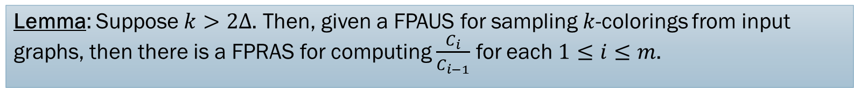
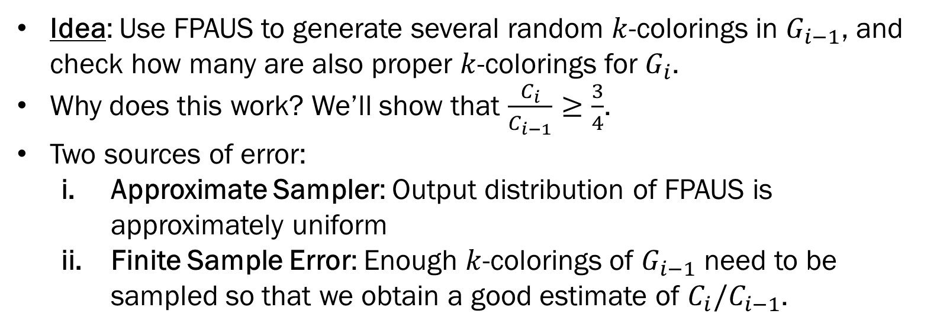
FPAUS to FPRAS: $k$-coloring
Lemma: Suppose $k>2Δ$. Then, given a FPAUS for sampling $k$-colorings from input graphs, then there is a FPRAS for computing $\frac{C_{i}}{C_{i−1}}$ for each $1≤i≤m$.
Idea: Use FPAUS to generate several random $k$-colorings in $G_{i−1}$, and check how many are also proper $k$-colorings for $G_{i}$.
Why does this work? We’ll show that $\frac{C_{i}}{C_{i−1}}≥\frac{3}{4}$.
Two sources of error:
  Approximate Sampler: Output distribution of FPAUS is approximately uniform
  Finite Sample Error: Enough $k$-colorings of $G_{i−1}$ need to be sampled so that we obtain a good estimate of $C_{i}/C_{i−1}$.

Slide 14

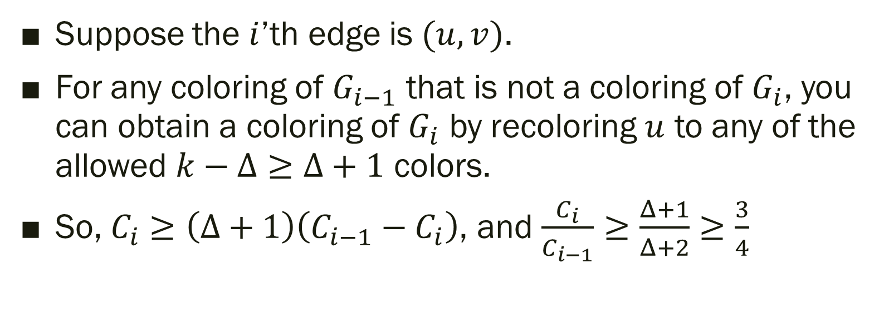
FPAUS to FPRAS: $k$-coloring
Claim: If $k>2Δ$,
$$\frac{C_{i}}{C_{i−1}}≥\frac{3}{4}$$
Suppose the $i$’th edge is $(u,v)$.
For any coloring of $G_{i−1}$ that is not a coloring of $G_{i}$, you can obtain a coloring of $G_{i}$ by recoloring $u$ to any of the allowed $k−Δ≥Δ+1$ colors.
So, $C_{i}≥\left(Δ+1\right)\left(C_{i−1}−C_{i}\right)$, and $\frac{C_{i}}{C_{i−1}}≥\frac{Δ+1}{Δ+2}≥\frac{3}{4}$

Slide 15
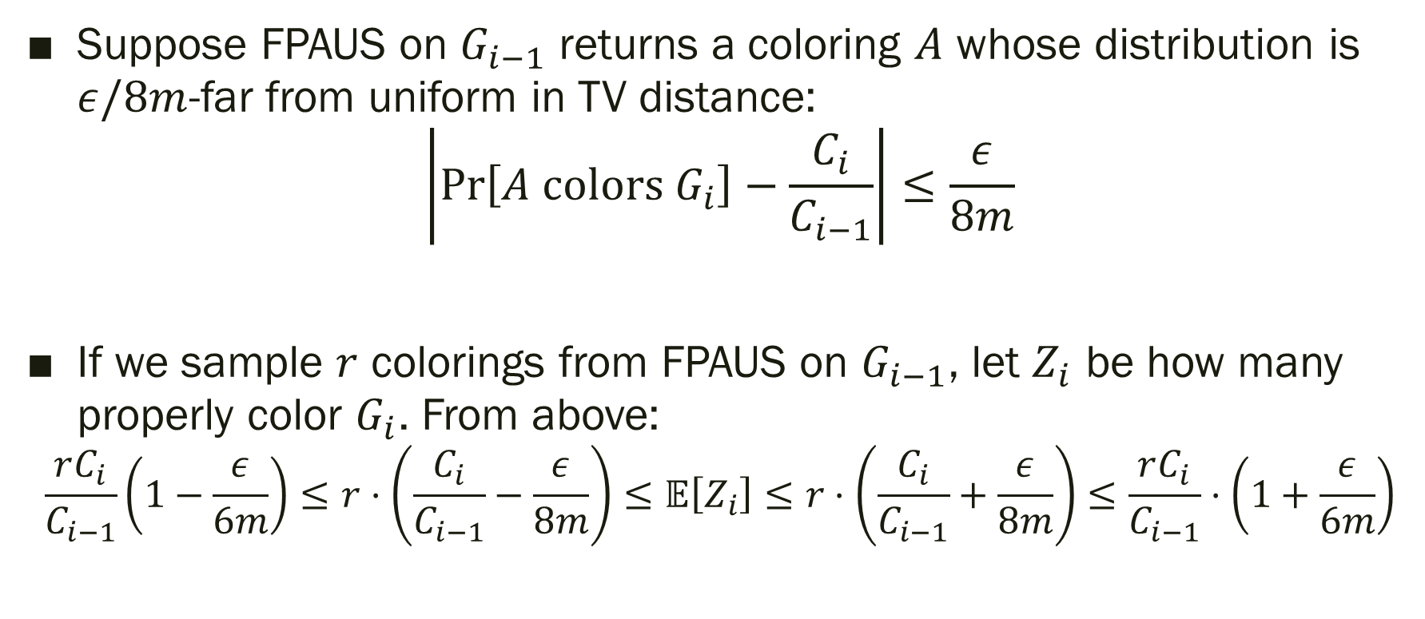
FPAUS to FPRAS: $k$-coloring
Suppose FPAUS on $G_{i−1}$ returns a coloring $A$ whose distribution is $ε/8m$-far from uniform in TV distance:
$$\left|\operatorname{Pr}\left[A \text{colors} G_{i}\right]−\frac{C_{i}}{C_{i−1}}\right|≤\frac{ε}{8m}$$
If we sample $r$ colorings from FPAUS on $G_{i−1}$, let $Z_{i}$ be how many properly color $G_{i}$. From above:
$$\frac{rC_{i}}{C_{i−1}}\left(1−\frac{ε}{6m}\right)≤r⋅\left(\frac{C_{i}}{C_{i−1}}−\frac{ε}{8m}\right)≤𝔼\left[Z_{i}\right]≤r⋅\left(\frac{C_{i}}{C_{i−1}}+\frac{ε}{8m}\right)≤\frac{rC_{i}}{C_{i−1}}⋅\left(1+\frac{ε}{6m}\right)$$

Slide 16
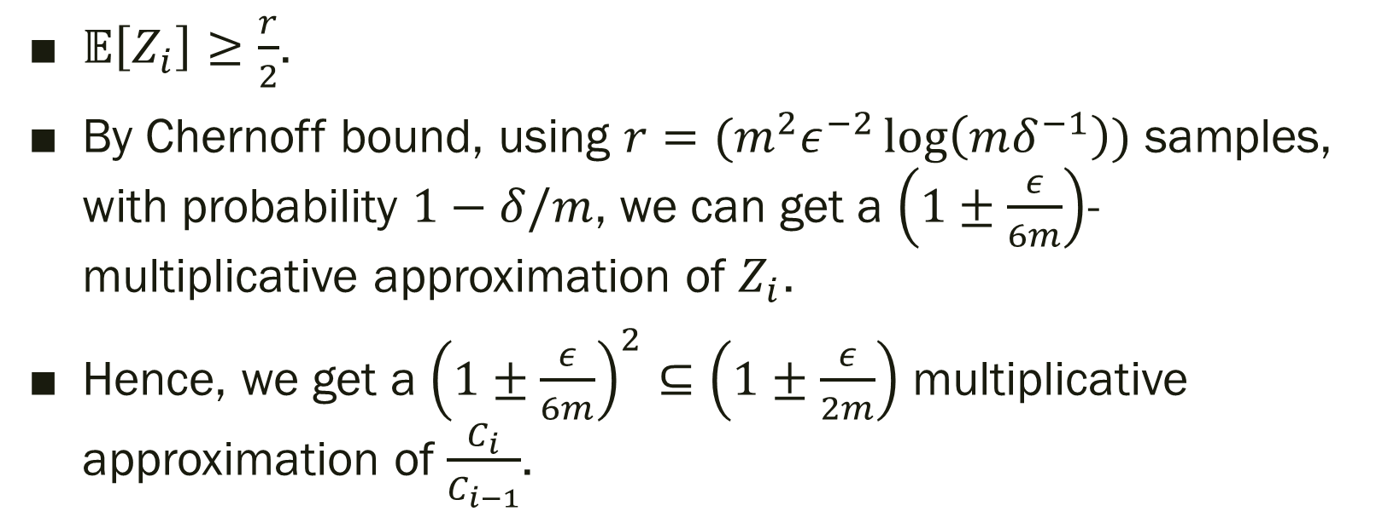
FPAUS to FPRAS: $k$-coloring
$𝔼\left[Z_{i}\right]≥\frac{r}{2}$.
By Chernoff bound, using $r=(m^{2}ε^{−2}\log\left(mδ^{−1}\right))$ samples, with probability $1−δ/m$, we can get a $\left(1±\frac{ε}{6m}\right)$-multiplicative approximation of $Z_{i}$.
Hence, we get a ${\left(1±\frac{ε}{6m}\right)}^{2}⊆\left(1±\frac{ε}{2m}\right)$ multiplicative approximation of $\frac{C_{i}}{C_{i−1}}$.

Slide 17
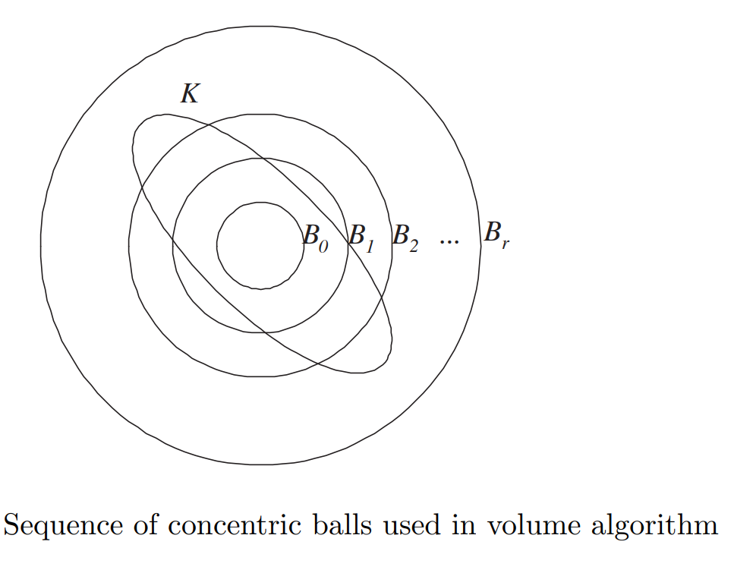
Takeaways (Counting)
Intimate connection between sampling and counting. What we saw is an example of a general paradigm that reduces a counting problem to a sampling problem. This works for any problem having a “downward self-reducibility” property.
Another prominent success story of this line of work is volume estimation of convex bodies. Can reduce to sampling uniformly from convex bodies.

Slide 18
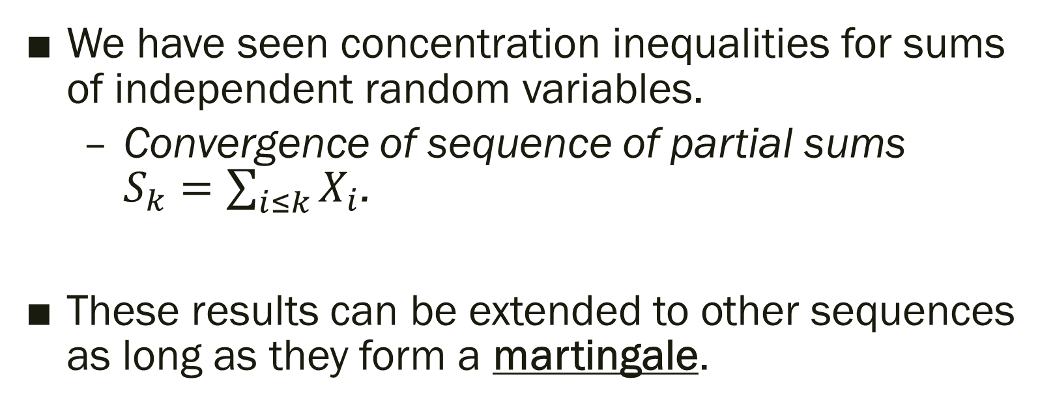
Sequence Convergence
We have seen concentration inequalities for sums of independent random variables.
  Convergence of sequence of partial sums
  $S_{k}=\sum_{i≤k}{X_{i}}$.
These results can be extended to other sequences as long as they form a martingale.

Slide 19
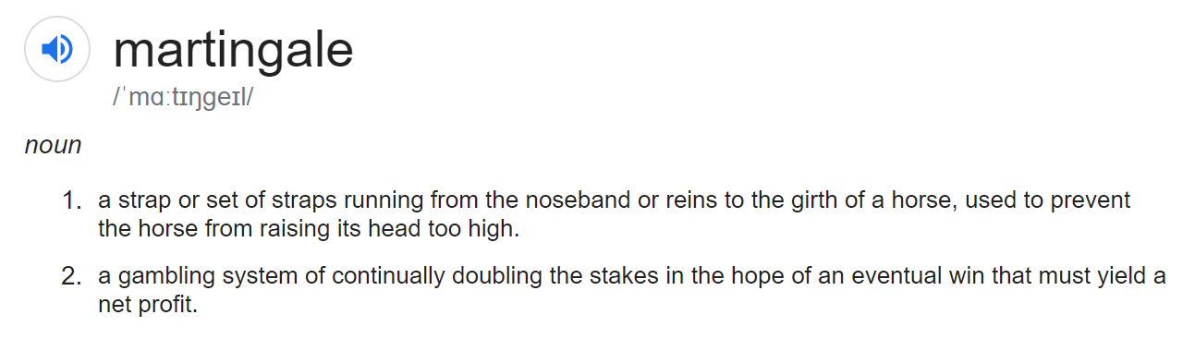
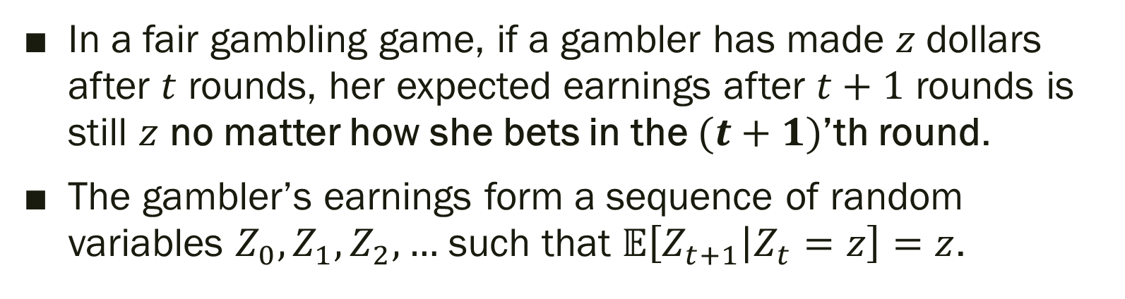
What is a martingale?
In a fair gambling game, if a gambler has made $z$ dollars after $t$ rounds, her expected earnings after $t+1$ rounds is still $z$ no matter how she bets in the $(t+1)$’th round.
The gambler’s earnings form a sequence of random variables $Z_{0},Z_{1},Z_{2},…$ such that $𝔼\left[Z_{t+1} | Z_{t}=z\right]=z$.

Slide 20
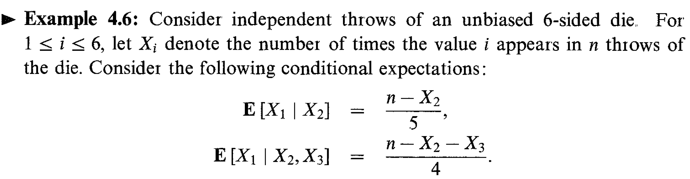
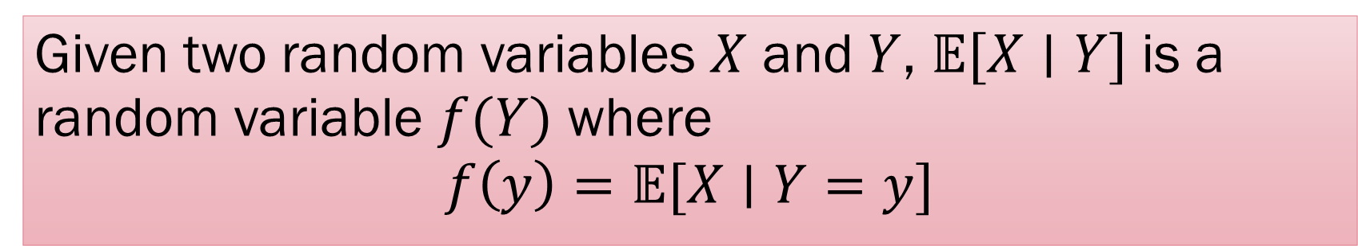
Conditional Expectations
Given two random variables $X$ and $Y$, $𝔼[X∣Y]$ is a random variable $f(Y)$ where
$$f\left(y\right)=𝔼[X∣Y=y]$$

Slide 21
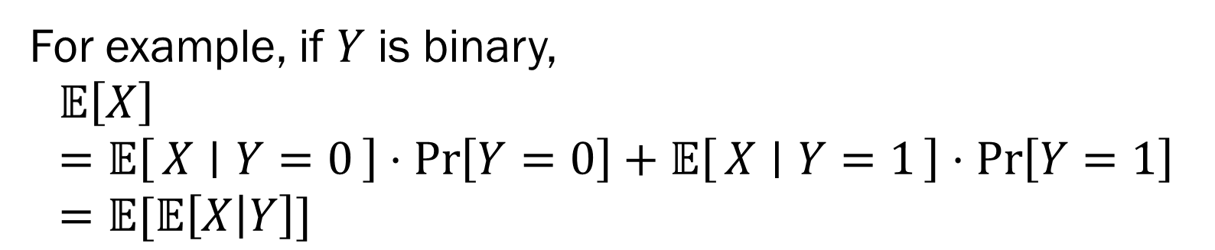

Law of Conditional Expectations
Lemma:
$$𝔼\left[𝔼\left[X | Y\right]\right]=𝔼[X]$$
For example, if $Y$ is binary,
$$𝔼\left[X\right]=𝔼\left[X ∣ Y=0\right]⋅\operatorname{Pr}\left[Y=0\right]+𝔼\left[X ∣ Y=1\right]⋅\operatorname{Pr}\left[Y=1\right]=𝔼[𝔼\left[X | Y\right]]$$

Slide 22

Law of Conditional Expectations
Lemma:
$$𝔼\left[𝔼\left[X | Y\right]\right]=𝔼[X]$$
More generally:
$$𝔼\left[𝔼\left[X ∣ Y,Z\right] ∣ Z\right]=𝔼[X∣Z]$$

Slide 23
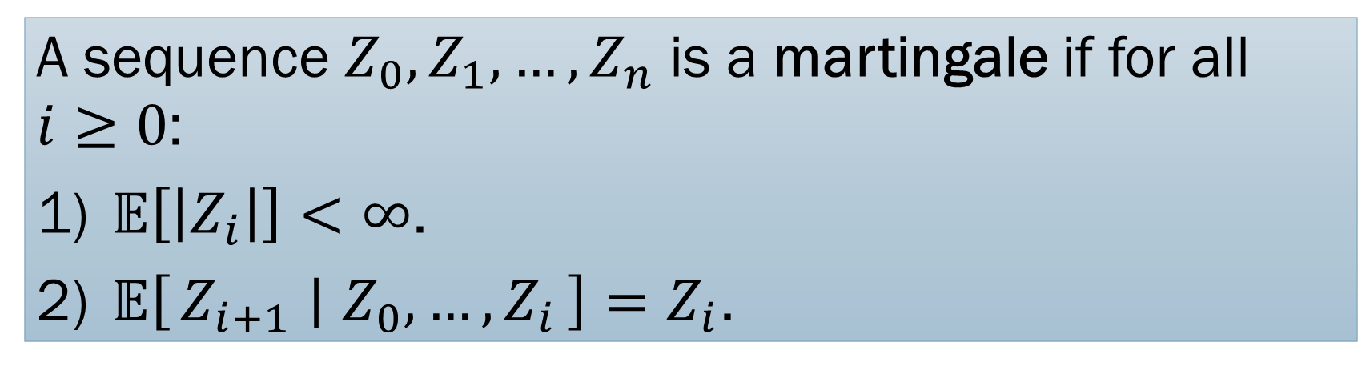
What is a martingale?
A sequence $Z_{0},Z_{1},…, Z_{n}$ is a martingale if for all $i≥0$:
$𝔼\left[\left|Z_{i}\right|\right]<∞$.
$𝔼\left[Z_{i+1} ∣ Z_{0},…, Z_{i}\right]=Z_{i}$.

Slide 24
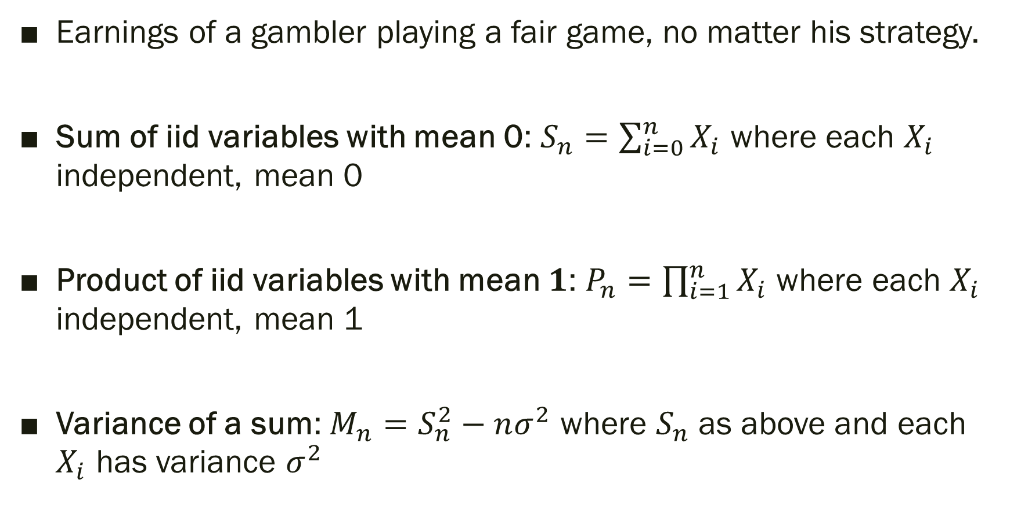
Examples of Martingales
Earnings of a gambler playing a fair game, no matter his strategy.
Sum of iid variables with mean 0: $S_{n}=\sum_{i=0}^{n}{X_{i}}$ where each $X_{i}$ independent, mean 0
Product of iid variables with mean $1$: $P_{n}=\prod_{i=1}^{n}{X_{i}}$ where each $X_{i}$ independent, mean 1
Variance of a sum: $M_{n}=S_{n}^{2}−nσ^{2}$ where $S_{n}$ as above and each $X_{i}$ has variance $σ^{2}$

Slide 25
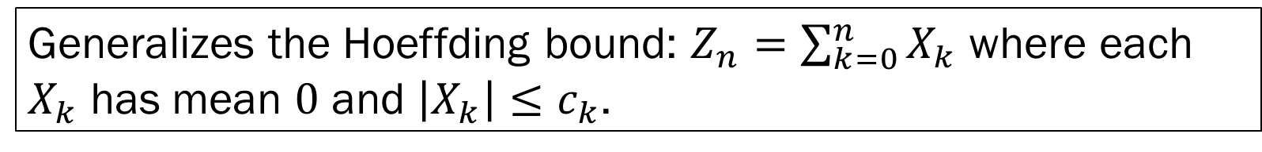
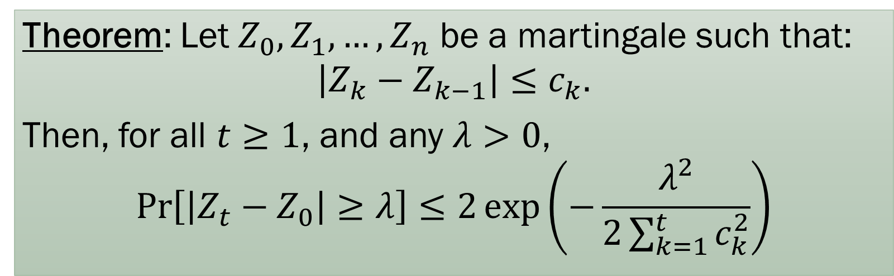
Concentration: Azuma-Hoeffding
Theorem: Let $Z_{0},Z_{1},…, Z_{n}$ be a martingale such that:
$$\left|Z_{k}−Z_{k−1}\right|≤c_{k}.$$
Then, for all $t≥1$, and any $λ>0$,
$$\operatorname{Pr}\left[\left|Z_{t}−Z_{0}\right|≥λ\right]≤2\exp\left(−\frac{λ^{2}}{2\sum_{k=1}^{t}{c_{k}^{2}}}\right)$$
Generalizes the Hoeffding bound: $Z_{n}=\sum_{k=0}^{n}{X_{k}}$ where each $X_{k}$ has mean $0$ and $\left|X_{k}\right|≤c_{k}$.

Slide 26
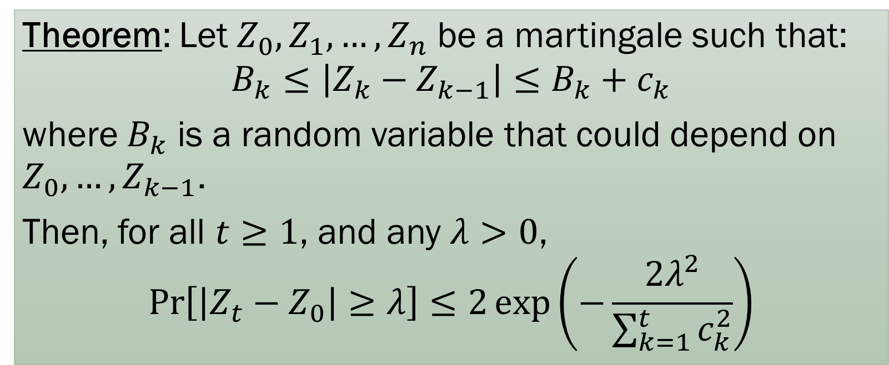
Concentration: Azuma-Hoeffding
Theorem: Let $Z_{0},Z_{1},…, Z_{n}$ be a martingale such that:
$$B_{k}≤\left|Z_{k}−Z_{k−1}\right|≤B_{k}+c_{k}$$
where $B_{k}$ is a random variable that could depend on $Z_{0},…, Z_{k−1}$.
Then, for all $t≥1$, and any $λ>0$,
$$\operatorname{Pr}\left[\left|Z_{t}−Z_{0}\right|≥λ\right]≤2\exp\left(−\frac{2λ^{2}}{\sum_{k=1}^{t}{c_{k}^{2}}}\right)$$

Slide 27
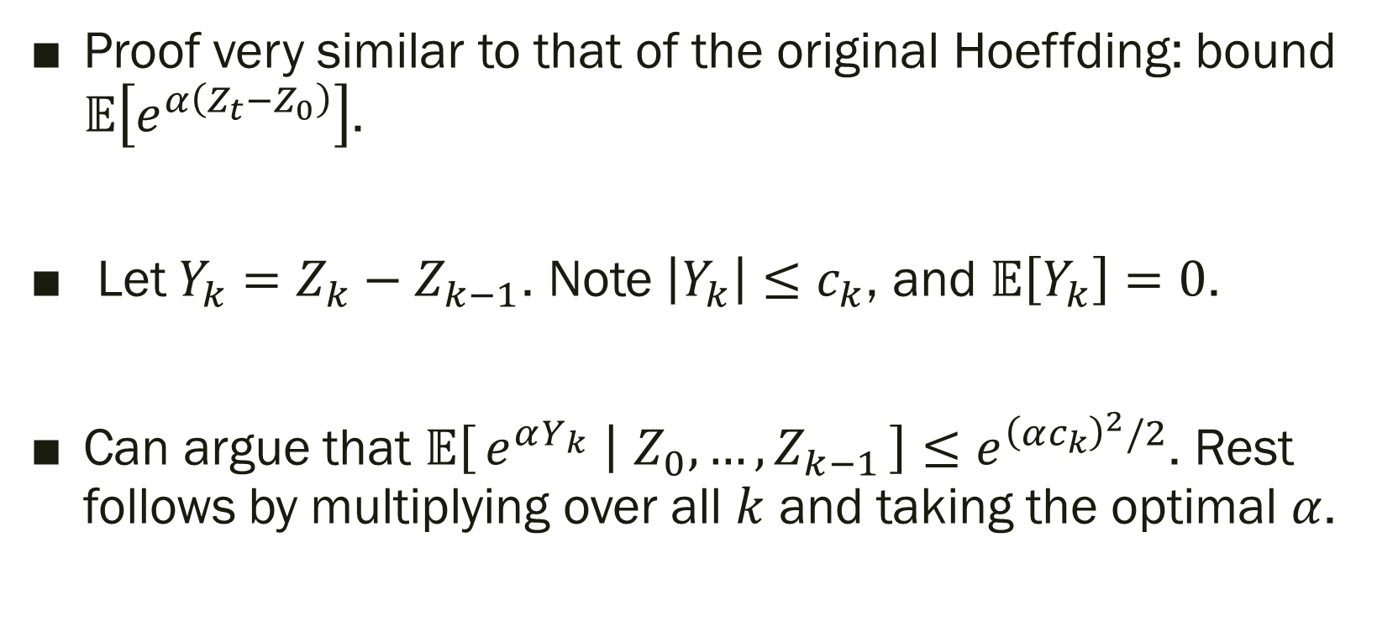
Proof of Azuma-Hoeffding
Proof very similar to that of the original Hoeffding: bound $𝔼\left[e^{α\left(Z_{t}−Z_{0}\right)}\right]$.
Let $Y_{k}=Z_{k}−Z_{k−1}$. Note $\left|Y_{k}\right|≤c_{k}$, and $𝔼\left[Y_{k}\right]=0$.
Can argue that $𝔼\left[e^{αY_{k}} ∣ Z_{0},…, Z_{k−1}\right]≤e^{{\left(αc_{k}\right)}^{2}/2}$. Rest follows by multiplying over all $k$ and taking the optimal $α$.

Slide 28
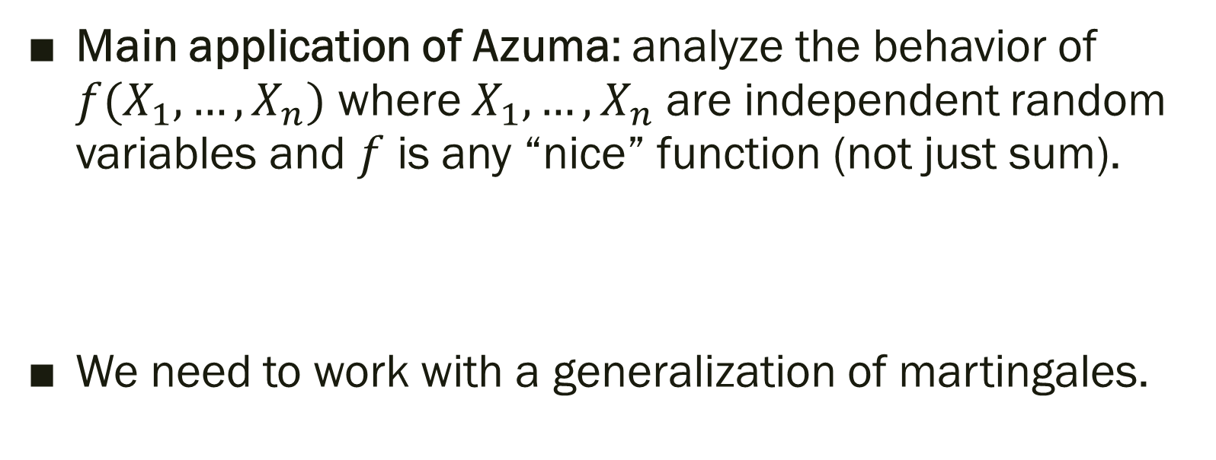
How do you use Azuma-Hoeffding?
Main application of Azuma: analyze the behavior of $f(X_{1},…, X_{n})$ where $X_{1},…, X_{n}$ are independent random variables and $f$ is any “nice” function (not just sum).
We need to work with a generalization of martingales.

Slide 29
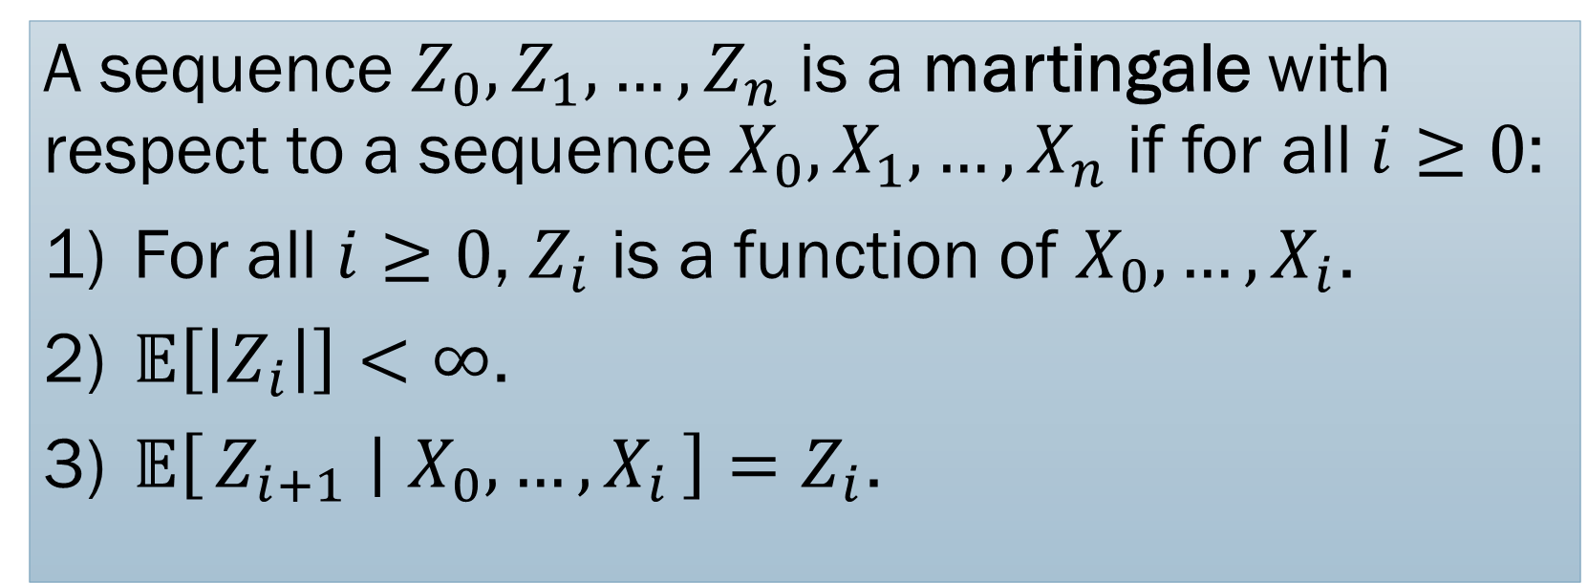
Martingale: general definition
A sequence $Z_{0},Z_{1},…, Z_{n}$ is a martingale with respect to a sequence $X_{0},X_{1},…, X_{n}$ if for all $i≥0$:
For all $i≥0$, $Z_{i}$ is a function of $X_{0},…, X_{i}$.
$𝔼\left[\left|Z_{i}\right|\right]<∞$.
$𝔼\left[Z_{i+1} ∣ X_{0},…, X_{i}\right]=Z_{i}$.

Slide 30

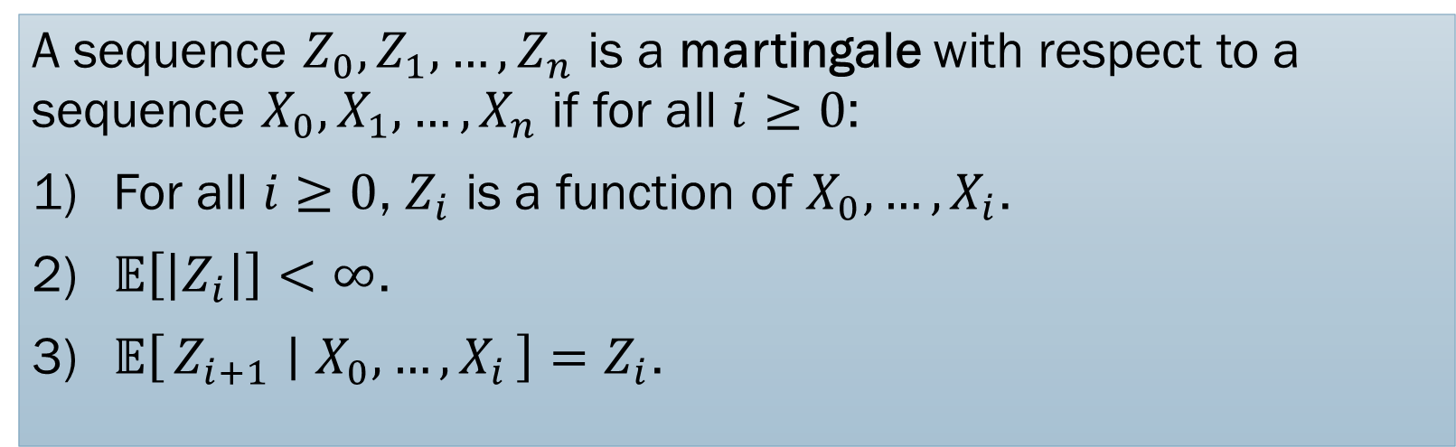
Martingale: general definition
A sequence $Z_{0},Z_{1},…, Z_{n}$ is a martingale with respect to a sequence $X_{0},X_{1},…, X_{n}$ if for all $i≥0$:
For all $i≥0$, $Z_{i}$ is a function of $X_{0},…, X_{i}$.
$𝔼\left[\left|Z_{i}\right|\right]<∞$.
$𝔼\left[Z_{i+1} ∣ X_{0},…, X_{i}\right]=Z_{i}$.
In the gambling example, $X_{i}$ is the amount won in the $i$’th game while $Z_{i}$ is the total earnings after the $i$’th game.

Slide 31
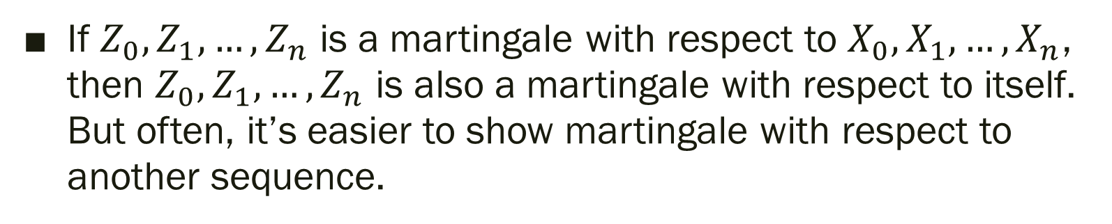
Martingale: general definition
A sequence $Z_{0},Z_{1},…, Z_{n}$ is a martingale with respect to a sequence $X_{0},X_{1},…, X_{n}$ if for all $i≥0$:
For all $i≥0$, $Z_{i}$ is a function of $X_{0},…, X_{i}$.
$𝔼\left[\left|Z_{i}\right|\right]<∞$.
$𝔼\left[Z_{i+1} ∣ X_{0},…, X_{i}\right]=Z_{i}$.
If $Z_{0},Z_{1},…, Z_{n}$ is a martingale with respect to $X_{0},X_{1},…, X_{n}$, then $Z_{0},Z_{1},…, Z_{n}$ is also a martingale with respect to itself. But often, it’s easier to show martingale with respect to another sequence.

Slide 32
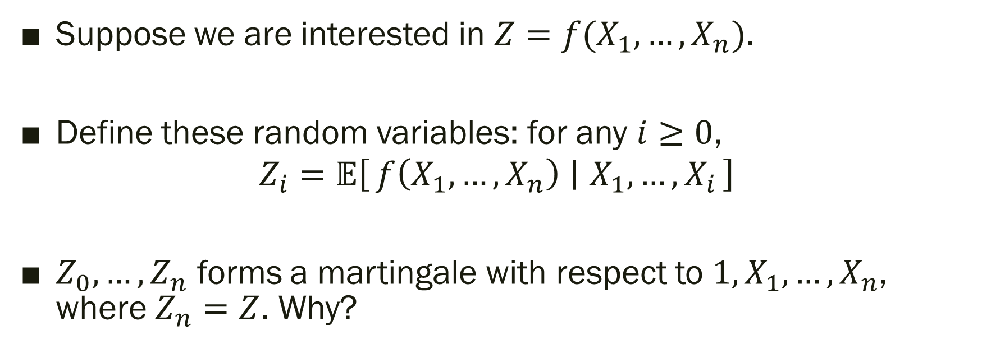
Doob Martingale
Suppose we are interested in $Z=f(X_{1},…, X_{n})$.
Define these random variables: for any $i≥0$,
$$Z_{i}=𝔼\left[f\left(X_{1},…, X_{n}\right) ∣ X_{1},…, X_{i}\right]$$
$Z_{0}, …, Z_{n}$ forms a martingale with respect to $1, X_{1},…, X_{n}$, where $Z_{n}=Z$. Why?

Slide 33
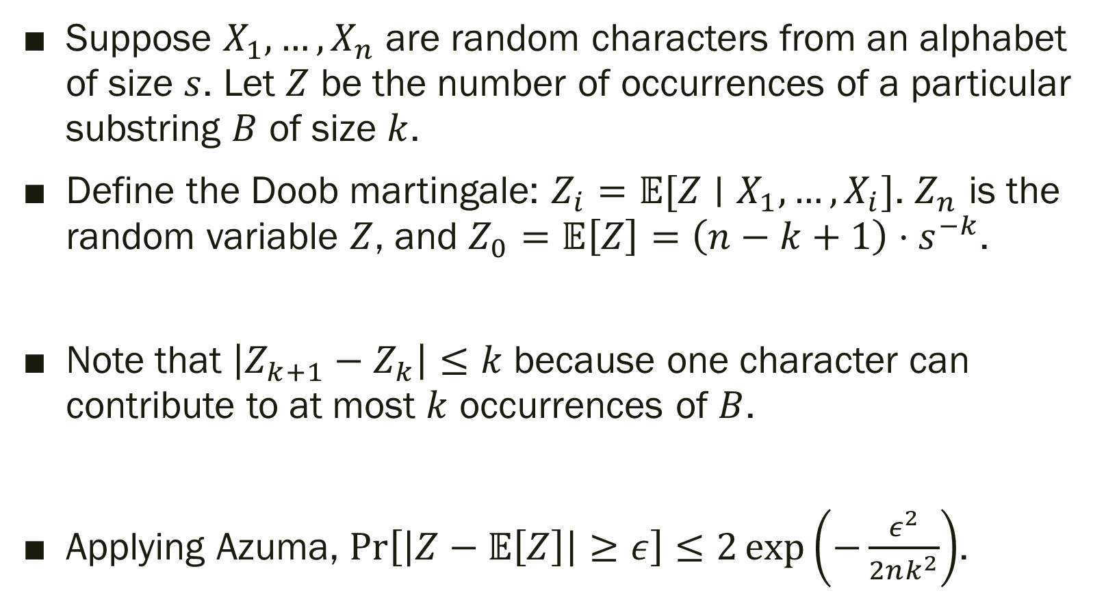
Example: Pattern Matching
Suppose $X_{1},…, X_{n}$ are random characters from an alphabet of size $s$. Let $Z$ be the number of occurrences of a particular substring $B$ of size $k$.
Define the Doob martingale: $Z_{i}=𝔼[Z∣X_{1},…, X_{i}]$. $Z_{n}$ is the random variable $Z$, and $Z_{0}=𝔼\left[Z\right]=\left(n−k+1\right)⋅s^{−k}$.
Note that $\left|Z_{k+1}−Z_{k}\right|≤k$ because one character can contribute to at most $k$ occurrences of $B$.
Applying Azuma, $\operatorname{Pr}\left[\left|Z−𝔼\left[Z\right]\right|≥ε\right]≤2\exp\left(−\frac{ε^{2}}{2nk^{2}}\right)$.

Slide 34
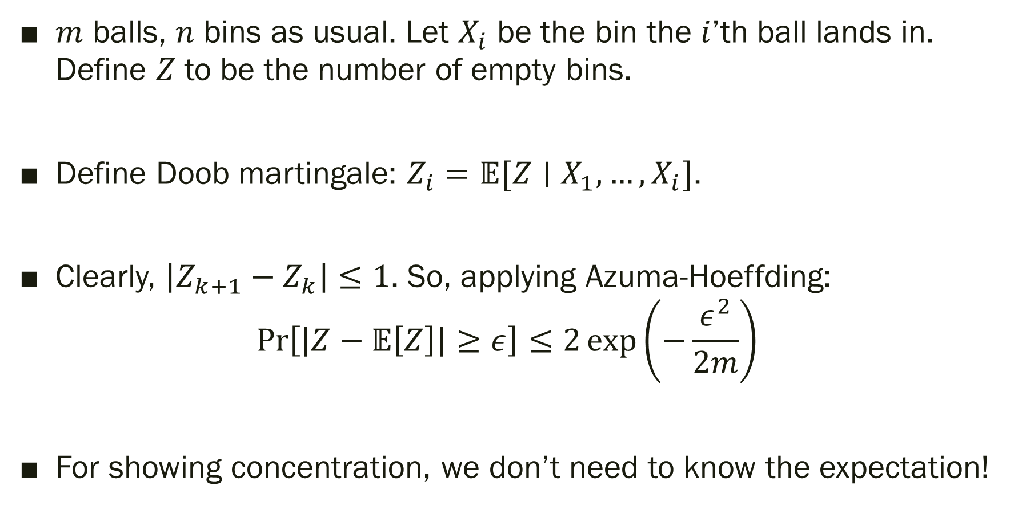
Example: Balls and Bins
$m$ balls, $n$ bins as usual. Let $X_{i}$ be the bin the $i$’th ball lands in. Define $Z$ to be the number of empty bins.
Define Doob martingale: $Z_{i}=𝔼[Z∣X_{1},…, X_{i}]$.
Clearly, $\left|Z_{k+1}−Z_{k}\right|≤1$. So, applying Azuma-Hoeffding:
$$\operatorname{Pr}\left[\left|Z−𝔼\left[Z\right]\right|≥ε\right]≤2\exp\left(−\frac{ε^{2}}{2m}\right)$$
For showing concentration, we don’t need to know the expectation!

Slide 35
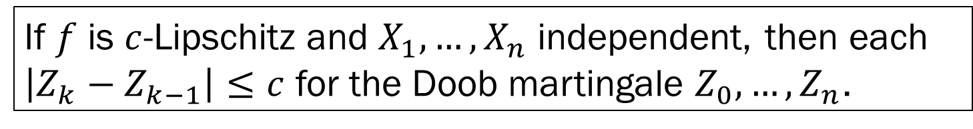
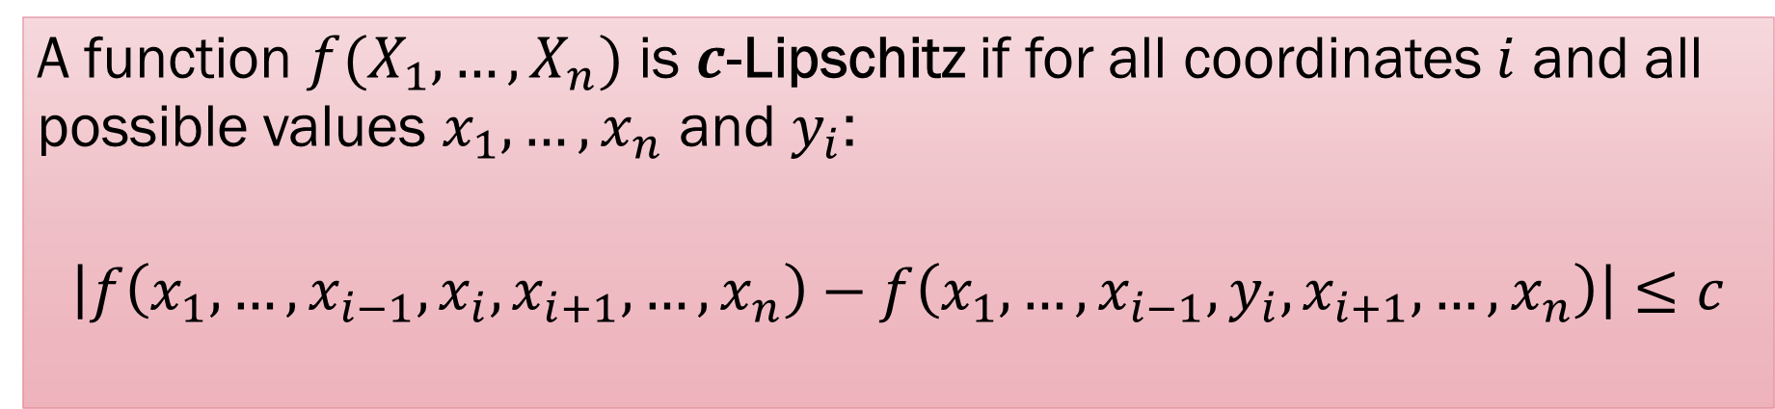
Applying Azuma to Doob
A function $f(X_{1},…, X_{n})$ is $c$-Lipschitz if for all coordinates $i$ and all possible values $x_{1},…, x_{n}$ and $y_{i}$:
$$\left|f\left(x_{1},…, x_{i−1}, x_{i},x_{i+1},…, x_{n}\right)−f\left(x_{1},…, x_{i−1},y_{i},x_{i+1}, …, x_{n}\right)\right|≤c$$
If $f$ is $c$-Lipschitz and $X_{1},…, X_{n}$ independent, then each $\left|Z_{k}−Z_{k−1}\right|≤c$ for the Doob martingale $Z_{0},…, Z_{n}$.

Slide 36
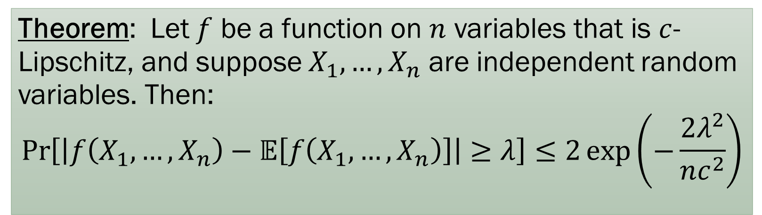
McDiarmid’s Inequality
Theorem: Let $f$ be a function on $n$ variables that is $c$-Lipschitz, and suppose $X_{1},…, X_{n}$ are independent random variables. Then:
$$\operatorname{Pr}\left[\left|f\left(X_{1},…, X_{n}\right)−𝔼\left[f\left(X_{1},…, X_{n}\right)\right]\right|≥λ\right]≤2\exp\left(−\frac{2λ^{2}}{nc^{2}}\right)$$

Slide 37
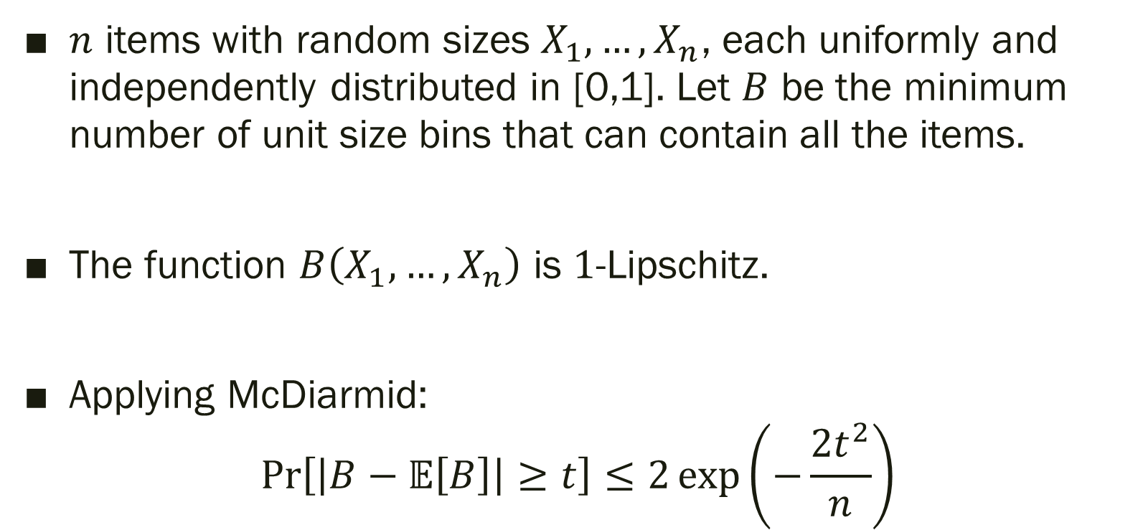
Example: Stochastic Bin Packing
$n$ items with random sizes $X_{1},…, X_{n}$, each uniformly and independently distributed in [0,1]. Let $B$ be the minimum number of unit size bins that can contain all the items.
The function $B\left(X_{1},…, X_{n}\right)$ is $1$-Lipschitz.
Applying McDiarmid:
$$\operatorname{Pr}\left[\left|B−𝔼\left[B\right]\right|≥t\right]≤2\exp\left(−\frac{2t^{2}}{n}\right)$$

Slide 38
Takeaways: Martingales
Sequences of random variables satisfying martingale conditions occur in lots of applications. Azuma-Hoeffding is a powerful tool to show Chernoff-like concentration.
Other interesting properties of martingales (stopping time theorem, Wald’s theorem) in the book that we didn’t cover.

